Slide 1
Introduction to software & programming language
Krishna Chakravarty

Slide 2
contents
Generation of languages
Classification of languages
Compilation process concepts, translator, linker, loader

Slide 3
Programming language
A set of instructions in a written in a language which is understandable to the computer.
Performs specific tasks
Allows human to communicate with the computer.
Development of programming language is governed by performance, new need in different fields, emerging programming methodologies etc.

Slide 4
Topic 1 : Generation of programming language

Slide 5

Generation of languages
First generation language (1GL)
Machine language
Written in binary code
Difficult to use, error prone.
Machine language varies from
one computer to another (dependent)

Slide 6
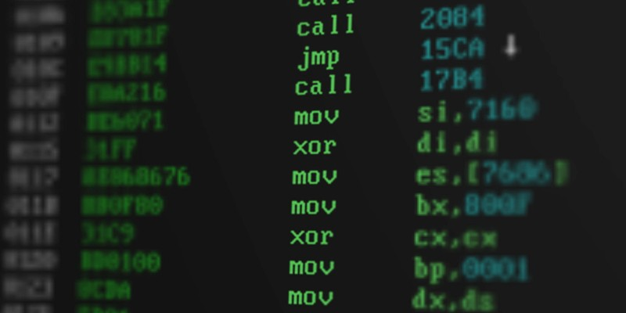
Generation of languages
Second generation language (2GL)
Assembly language
Mnemonic code is used to express instructions.
Mnemonic is an abbreviation of operation. (inc = increase by one)
Also machine dependent
Programming is very difficult here too.

Slide 7
Generation of languages
Third generation language (3GL)
High level language
C, C++, COBOL, FORTRAN, BASIC, PASCAL
Instructions are similar to English language
Logical sequence is there.
This must be translated to machine language by compiler or interpreter.
One statement in 3GL several machine language instructions
Advantages
Readability
Portability (can un on different machines)
Easy debugging, Ease in software development

Slide 8
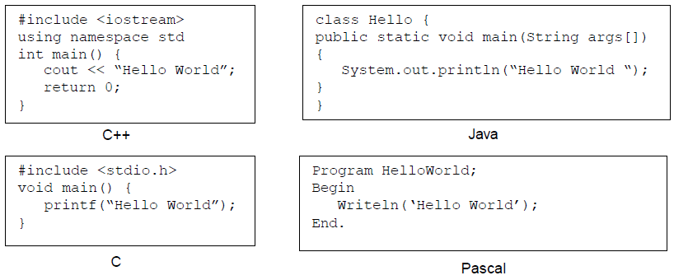
Generation of languages
Third generation language (3GL)

Slide 9
Generation of languages
Fourth generation language (4GL)
Non procedural
Very specific, fewer instructions to perform a task.
Usually used in database queries, reports, data manipulations etc.
Ex : SQL query
SELECT address from EMP where empname = ‘MAHIMA’
Advantages
Machine independent (can un on different machines)
Easy to learn
Programming effort is reduced.

Slide 10
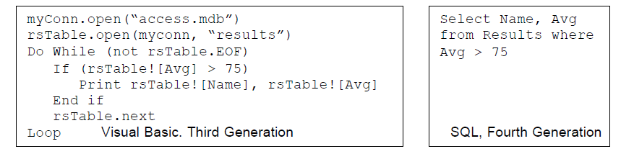
Generation of languages

Slide 11
Generation of languages
Fifth generation language (5GL)
Mostly like 4GL, also knows as natural languages
Based on solving constraints given to a program
Commands are highly sophisticated
Mainly used in artificial intelligence
Programmer need not learn the language grammar and syntaxes
Uses visual tools, graphic development interface.

Slide 12
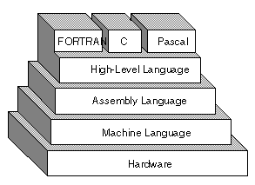
hierarchy

Slide 13
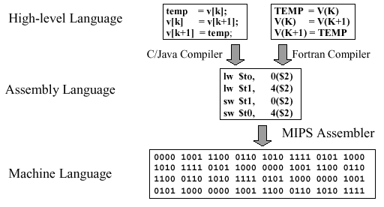
Finally machine language

Slide 14
Topic 2 : classification of programming language

Slide 15
Classification of languages
According to the extent of translation needed to generate the machine instruction from the program
High level language
Low level language
Easily understandable, more like English.
Need to be translated /compiled before it gets executed.
Machine independent, portable
More close to machine (either machine language or assembly language).
Does not require translator or processor as they are very close to native language of the computer
Machine dependent, not portable

Slide 16
Classification of languages
High level language
Procedural
Non Procedural
Problem Oriented
Algorithmic
Functional
Numerical
Object Oriented
Logic based
symbolic
Scripting
Publishing

Slide 17
Procedural language
Procedural
A set of logically related instructions executed in order
Divided into small self contained segment to perform particular task and reused when required,
Algorithmic
Top down approach, Algorithmic steps
Problem is divided into sub programs (functions or sub routines)
C, COBOL, FORTRAN, PASCAL
Object Oriented
Programming paradigm based upon objects (having both data and methods)
Aims to incorporate the advantages of modularity and reusability.
Abstraction, Encapsulation, Inheritance , polymorphism
Scripting
Sticks various components together, gluing tool.
UNIX shell, now VB script, Python etc

Slide 18
Topic 3 : compilation process concepts translator, linker, loader

Slide 19
Compilation process concepts (chapter – 8, pg 139)
Source code
Lexical analysis
Source code is scanned for lexical units(vocab of language)like keyword, identifier etc)
Parsing , checks the syntax rule of programming language
Syntactic analysis
Semantic analysis
Statement’s meaning is clear and consistent with the control flow and data types.
Intermediate code generation
To make the target program faster and smaller
In most cases this is assembly language.
Code generation
Final target code is generated in predefined target language template (machine language). This is in now executable form.

Slide 20
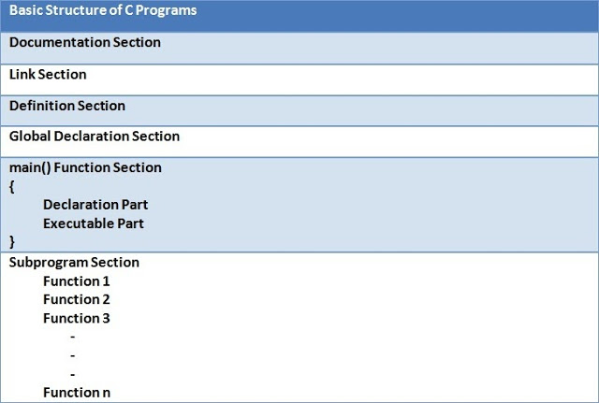
Basic structure of c program

Slide 21
Translator, linker loader
Translator : three types
Assembler (assembly language to machine language)
Compiler (translates the source to object code at once)
Interpreter (translates each line of source code, slower)
Depending on implementation , high level language uses
either compiler or interpreter(Basic) o both (Java).
For debugging, interpreted language is better than compiled language.
Java uses both compiler and interpreter

Slide 22
Translator, linker loader
Linker
High level language provides libraries so that certain common operation can be reused.
In C, all subprograms and common variables need to be linked to form an useful execution unit (they were separately translated as different units)
Linking makes the address of the programs known to each other or to the main program so that transfer of control from one point to another takes place during execution.

Slide 23
Translator, linker loader
Loader
Brings program from secondary memory to primary memory (RAM – ROM).
So that it can run. Initiates execution.
Ex : Bootstrap loader is an absolute loader which is executed when computer is switched on or restarted.
The main program is loaded into main memory and gets executed. When a function or subroutine is called, checks if it is already loaded is not then loads into the memory.
Random memory allocation happens depending on availability but the memory addresses are updated in program’s address tables.

